Slide 1
Educational Organization Using Servicenow
SlideMake.com

Slide 2
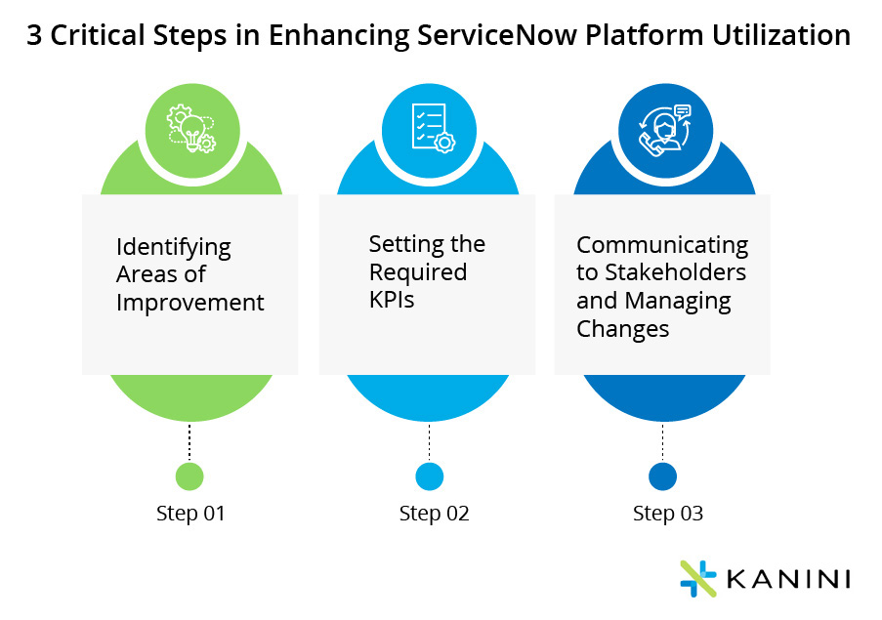
Introduction to Educational Organizations Using ServiceNow
ServiceNow is a cloud-based platform that streamlines operational processes for educational institutions.
It offers a centralized system for managing IT, administrative, and student services.
Educational organizations leverage ServiceNow to improve efficiency and enhance student and staff experiences.
Notes:
Image source: https://kanini.com

Slide 3
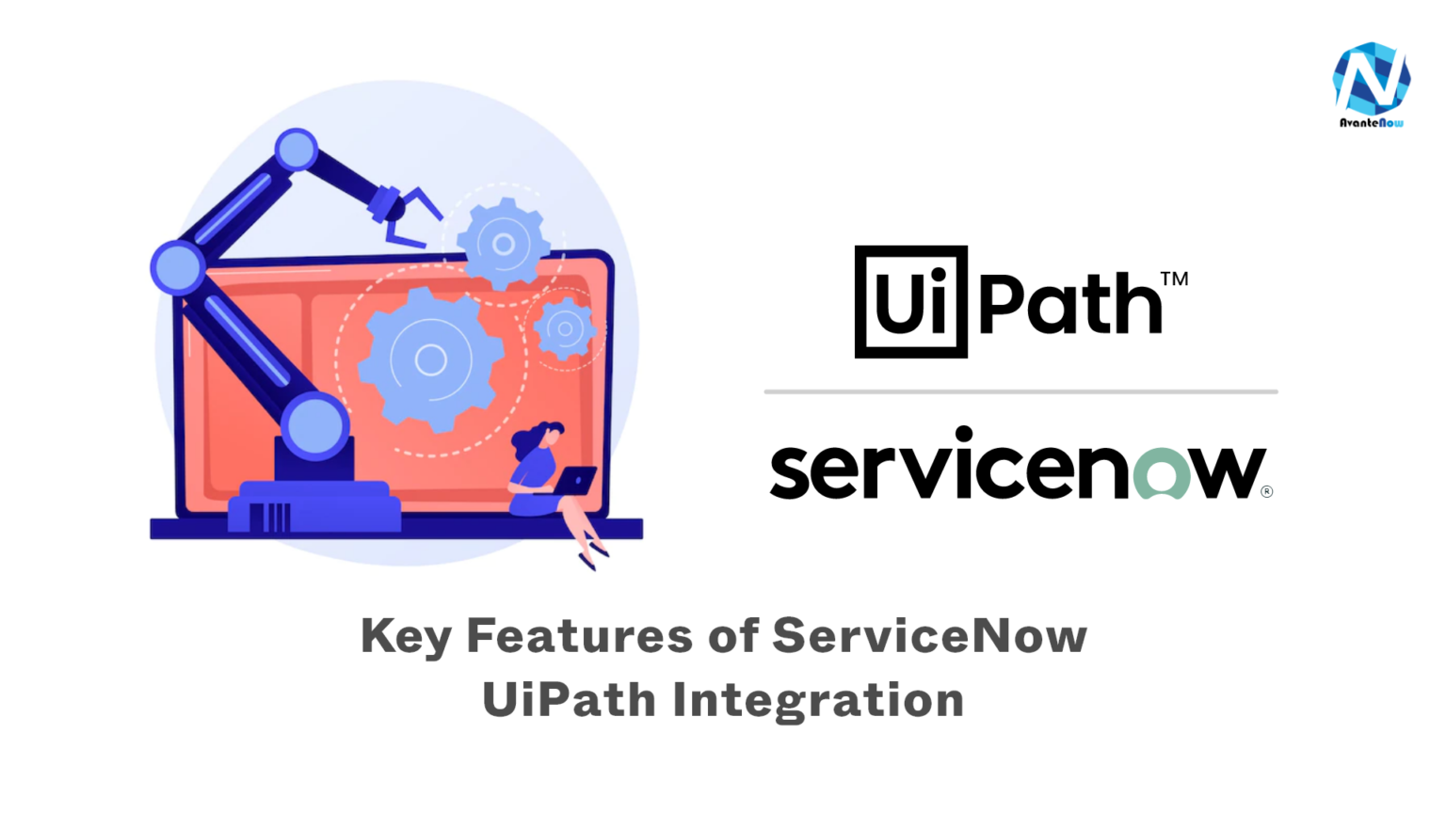
Key Features of ServiceNow in Education
ServiceNow provides customizable workflows tailored to the needs of educational institutions.
It includes modules for IT service management, facilities, HR, and student support.
Automation capabilities help reduce manual tasks and increase operational productivity.
Notes:
Image source: https://avantenow.com

Slide 4
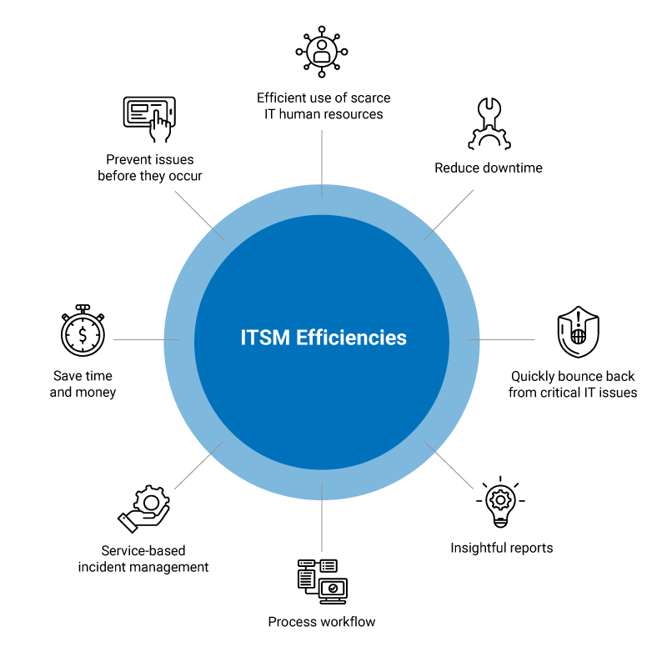
Benefits for Educational Institutions
Implementing ServiceNow can lead to faster resolution of student and staff requests.
It enhances transparency and communication across departments.
The platform supports data-driven decision-making through comprehensive reporting and analytics.
Notes:
Image source: https://arcticit.com

Slide 5
IT Service Management (ITSM) in Education
ServiceNow’s ITSM module helps manage hardware, software, and network issues effectively.
It allows for self-service portals where students and staff can submit and track requests.
Automated workflows ensure timely resolution and improve overall IT support quality.
Notes:
Image source: https://arcticit.com

Slide 6
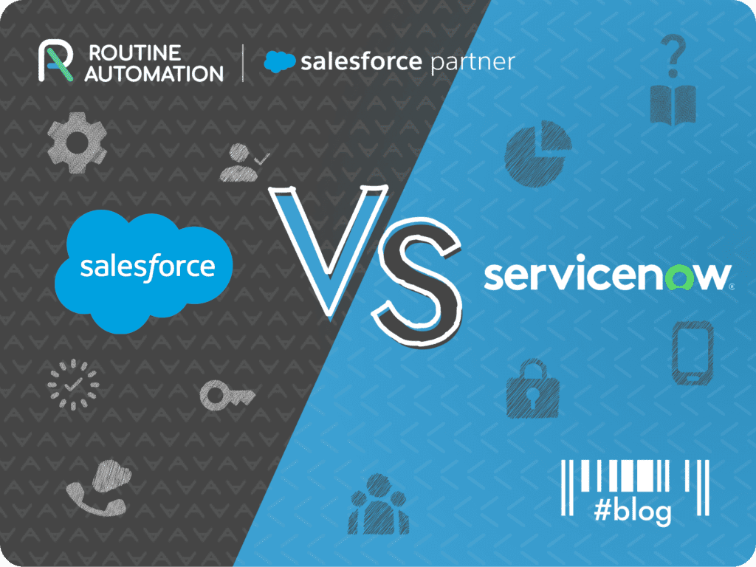
Student and Staff Support Automation
ServiceNow automates routine inquiries, freeing staff to handle more complex issues.
The platform offers knowledge bases for self-help, reducing dependency on support staff.
It provides personalized portals for students and staff to access services conveniently.
Notes:
Image source: https://routine-automation.com

Slide 7

Facilities and Asset Management
Educational institutions can use ServiceNow to track campus facilities and assets efficiently.
Maintenance requests, space management, and resource allocation are streamlined.
Real-time data helps in planning and optimizing campus operations.
Notes:
Image source: https://omnia360fs.com

Slide 8
HR Service Delivery in Education
ServiceNow supports onboarding, offboarding, and HR inquiries for faculty and staff.
It automates approval workflows and document management processes.
Enhancing HR services improves employee satisfaction and operational efficiency.
Notes:
Image source: https://www.servicenow.com

Slide 9
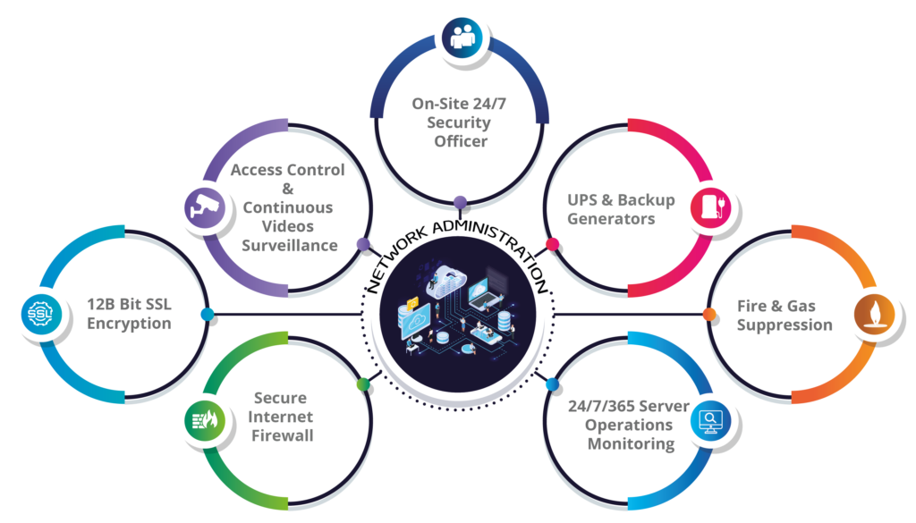
Data Security and Compliance
ServiceNow ensures data privacy through role-based access controls suited for educational data.
The platform supports compliance with regulations like FERPA and GDPR.
Regular audits and logs help maintain data integrity and security.
Notes:
Image source: https://www.orientalsolutions.com

Slide 10

Implementation Challenges and Best Practices
Successful deployment requires stakeholder engagement and clear planning.
Customization should align with institutional goals without overcomplicating workflows.
Ongoing training and support are essential for maximizing platform benefits.
Notes:
Image source: https://www.automation.com

Slide 11

Future Trends and Opportunities
Integration with AI and machine learning can further automate educational processes.
Mobile app development enhances access for students, staff, and administrators.
Continuous updates and innovations will help educational institutions stay agile and responsive.
Notes:
Image source: https://www.slidemake.com

Slide 12
References
ServiceNow Official Documentation and Resources.
Case Studies on Education Sector Implementations.
Industry Reports on Digital Transformation in Education.

